Slide 1
Light: its nature and its properties
Lecturer: Mauro Mosca
(www.dieet.unipa.it/tfl)
last update: 29/09/2021
University of Palermo – Master in Electronic Engineering

Slide 2

Waves
Longitudinal waves
Transversal waves

Slide 3
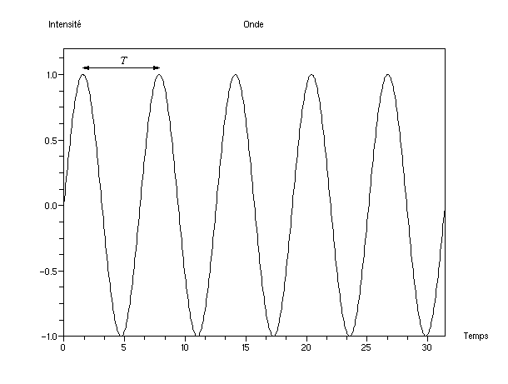
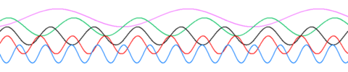
Frequency and wavelength
Not all waves travel…
…at a fixed point in space
standing waves

Slide 4
Frequency and wavelength
λ
λ/T = λf = v

Slide 5
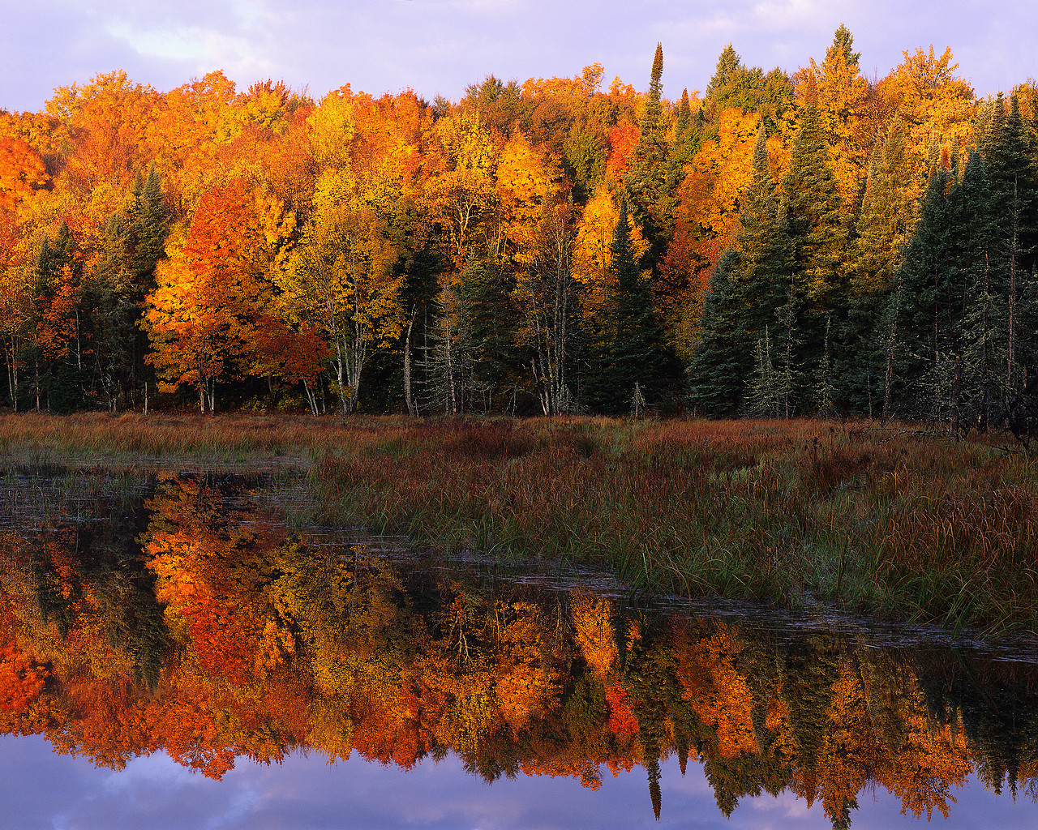
Light
Waves
or
particles
+
?
reflection, refraction
shadows
Electromagnetic and quantum theory are in perfect agreement if we assume that the amplitude of a field (electric or magnetic) at a certain point and at a certain instant is proportional to the probability (wave function) of finding a photon

Slide 6
Light properties
Reflection
θ_{i}
θ_{r}
θ_{i} = θ_{r}
n₁
n₂
θ_{t}
n₁sinθ_{i} = n₂sinθ_{t}
Refraction

Slide 7
Refractive indices

Slide 8


Why refraction?
n₁ = 1
?
n₂ = 1,3

Slide 9
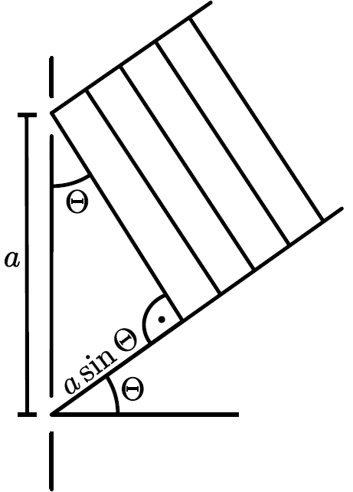
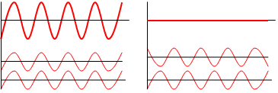
Interference: some pretty simple math...
asinθ = nλ
asinθ = (n+1/2)λ

Slide 10
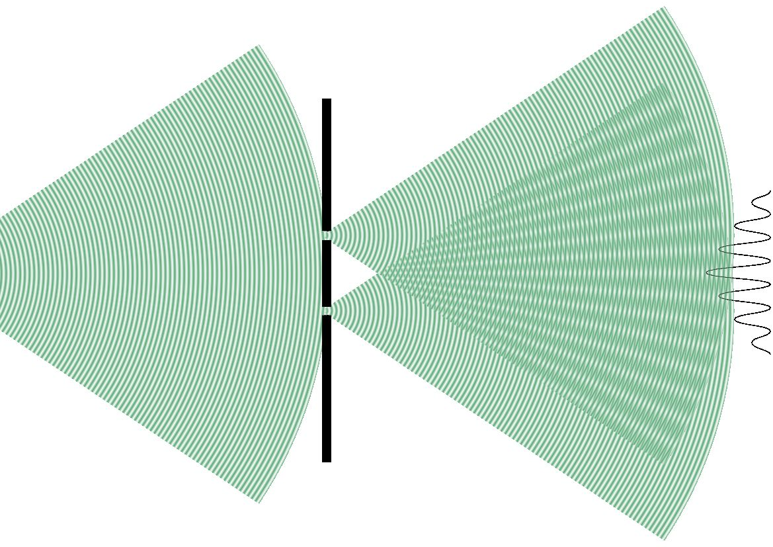

Web project:
ngsir.netfirms.com

Slide 11
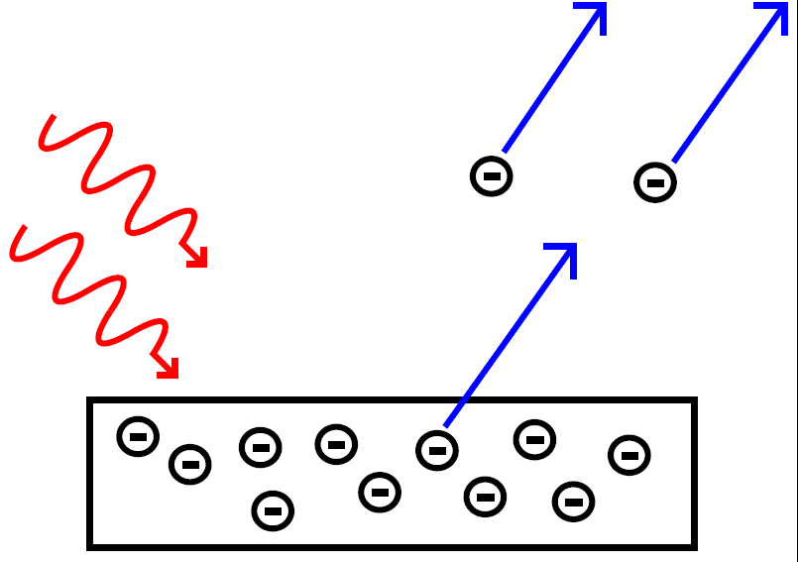
Photoelectric effect
both velocity and energy of electrons independent of light intensity
both velocity and energy of electrons dependent on color of light
electrons insensitive to some colors

Slide 12
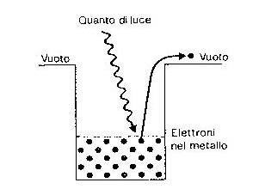
Photons
photons
Light = “energy packets”
E = hf = hc/λ (Planck-Einstein relation)

Slide 13
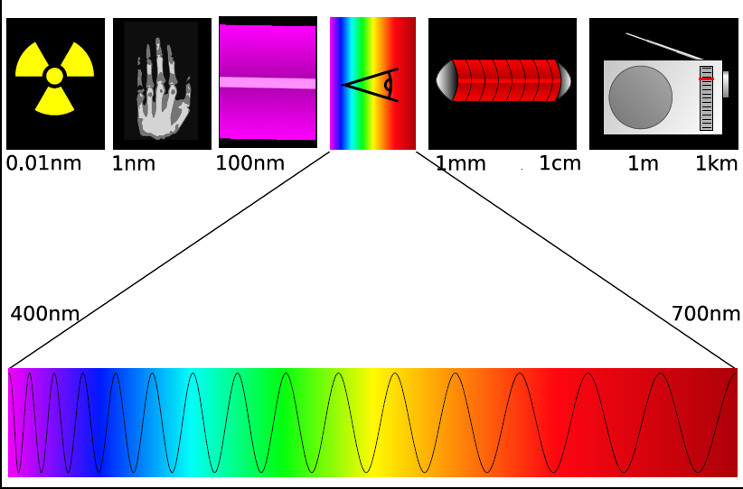
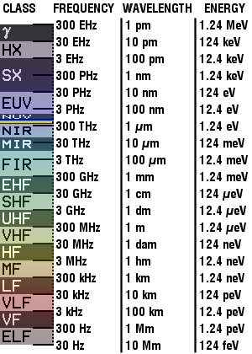
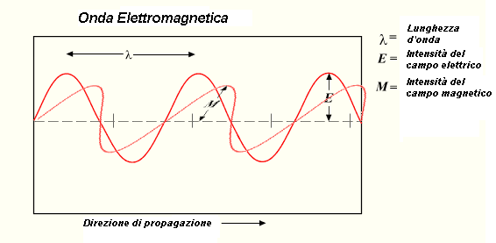
Electromagnetic spectrum

Slide 14
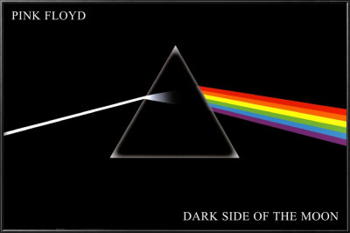
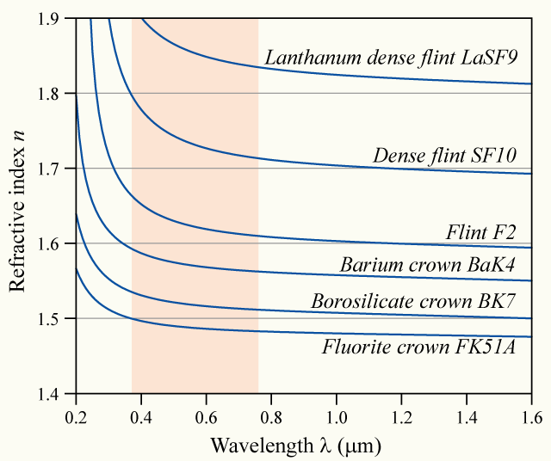
Dispersion
n = n (λ)
v function of λ

Slide 15
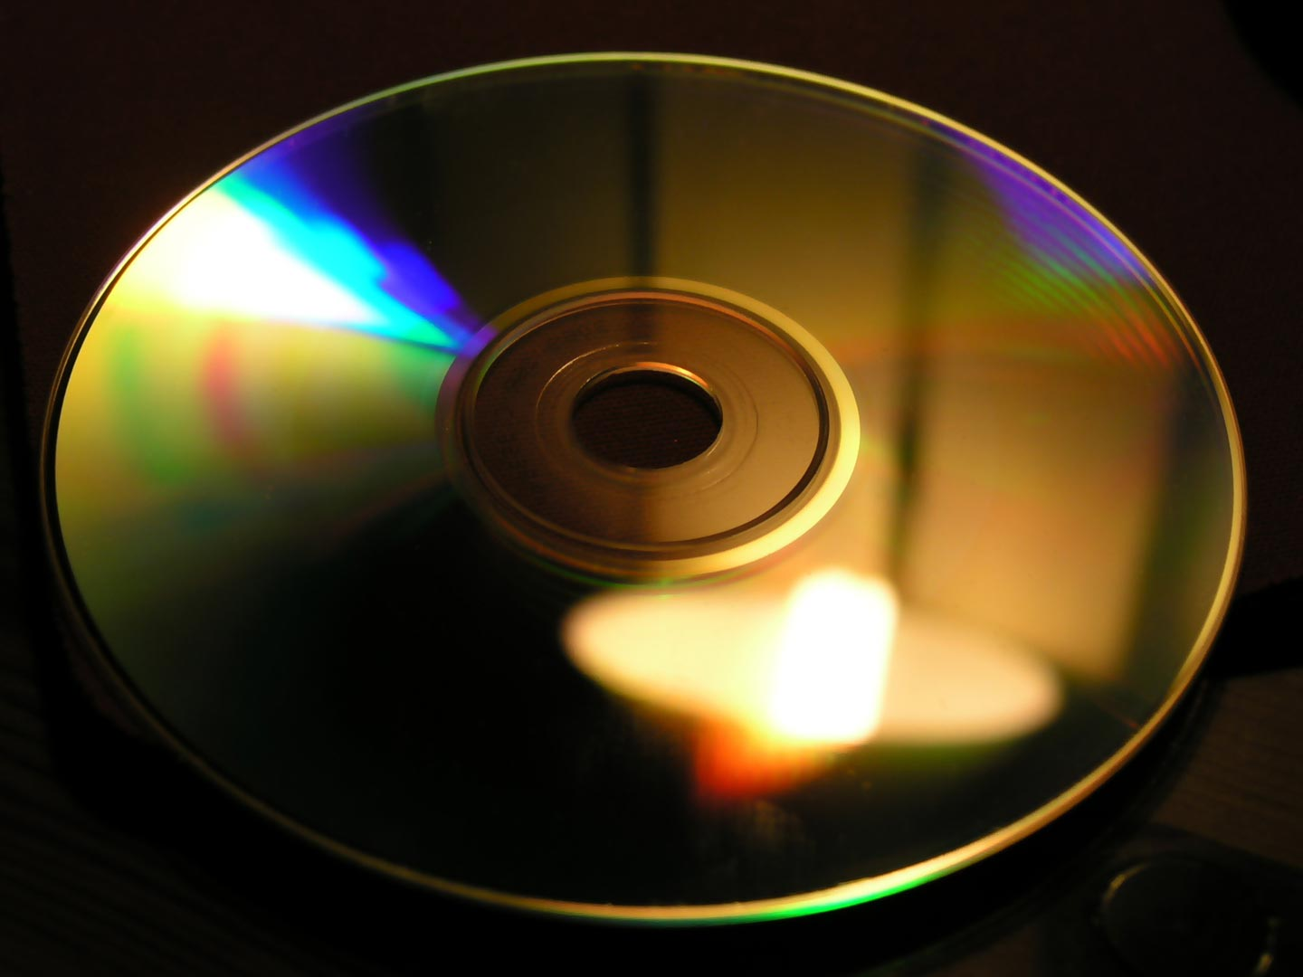
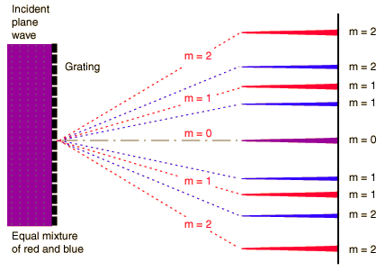
Gratings
in trasmission
in reflection
ordine 1
asinθ = nλ

Slide 16
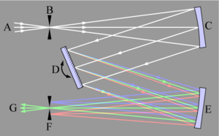
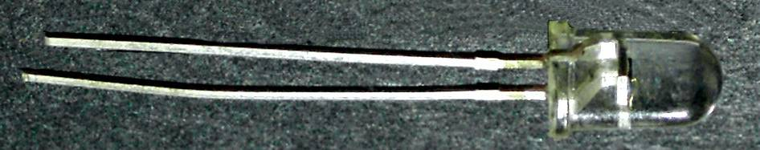
Spectrometer
mirrors
slit
resolution?…

Slide 17
Polarization of light
E
polarized light
H
non-polarized
light

Slide 18
Polarizers
E

Slide 19
Optical activity
ability of some crystals to rotate the wave
polarization plane
possible in crystals that exhibit
birefringence

Slide 20
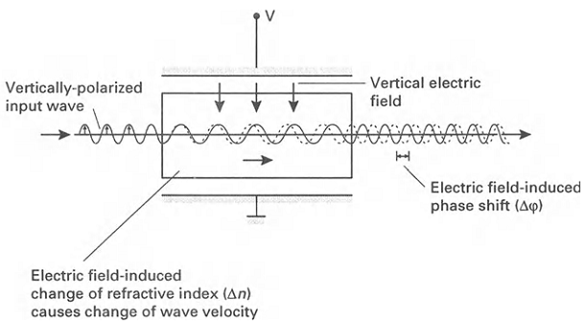
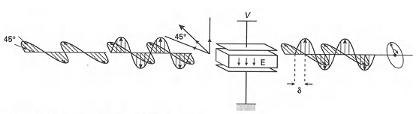


Light modulation

Slide 21
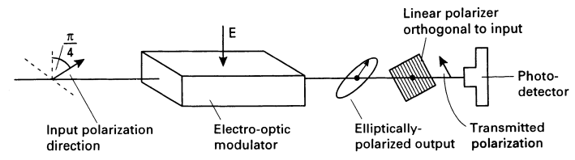
Light modulation: amplitude modulation
= f(t)

